Slide 1


EV ASSISTANT
Smart, Sustainable & User-Friendly Electric Vehicle Assistant
Team Lead : Sejal C. Shirsath
Team Member : Chaitali R. Mahajan
Team Member : Mohini R. Tupe
Mentor Name : Prof. Sagar Yadav Sir
College Name : PES’s Modern College of Engineering, Pune

Slide 2

Project Objectives
Problem Statement
Project Overview – Introduction
End Users
Wow Factor in Project
Modelling/Block Diagram/Flow of Project
Result/outcomes
Conclusion
Future Perspective

Slide 3




Problem Statement:
Electric vehicle users face challenges in choosing suitable EVs, finding nearby charging stations, and estimating charging time. The EV Assistant provides EV recommendations, charging station search, charging time estimation, and FAQs to support efficient and hassle-free EV travel.

Slide 4

Project Overview - Introduction
With the rapid adoption of Electric Vehicles (EVs), users often face challenges related to vehicle selection, trip planning, charging station availability, and charging time estimation. Lack of proper guidance leads to range anxiety and inefficient travel planning. The EV Assistant is an intelligent, user-friendly web application developed using Streamlit that helps EV users make informed decisions. The system provides EV recommendations, nearby charging station search, charging time estimation, and an interactive FAQ chatbot. By integrating data analytics and machine learning techniques, the EV Assistant simplifies EV ownership and promotes sustainable transportation.

Slide 5
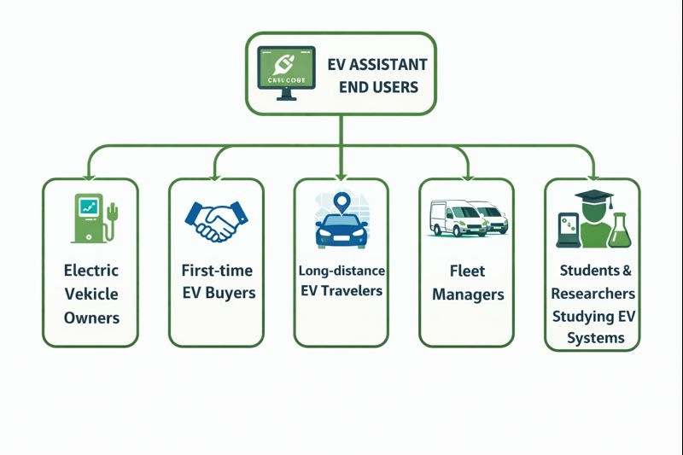
End Users
Electric Vehicle owners
First-time EV buyers
Long-distance EV travelers
Fleet managers
Students & researchers studying EV systems
h

Slide 6
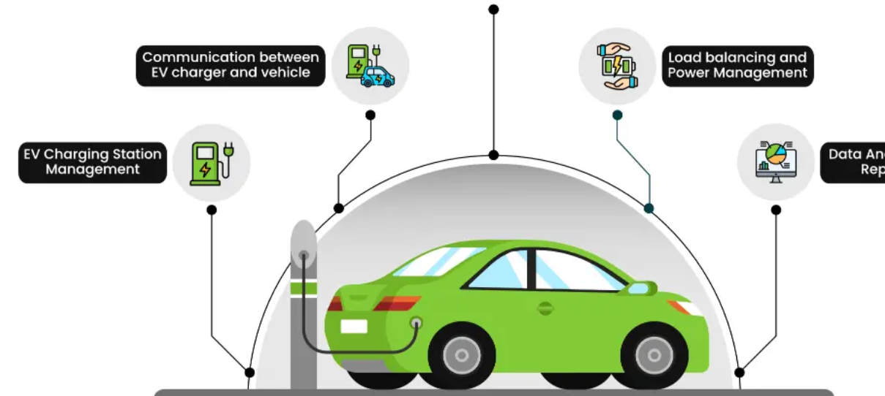
Wow Factors in Project
All-in-one EV Assistant on a single platform
EV Recommendation System using similarity analysis
Location-based charging station search with distance calculation
Charging Time Estimator for trip planning
Smart FAQ Chatbot for instant EV knowledge
Eco-friendly green UI theme
No complex setup – web-based & interactive

Slide 7

Modelling/Block Diagram/Flow of Project
Charging Station Finder
Nearest Station Found
Load EV, Station & FAQ Datasets
Data Preprocessing (Cleaning & Scaling)
User Selects Module (EV / Station / Time FAQ)
Charging Time Model
Estimate Charging Time
START
FAQ’s
END
EV Recommendation Model
Similar EV’s Displayed

Slide 8




Technology Stack
Frontend:
        - Streamlit – Interactive web interface
    - HTML & CSS – UI styling and green theme design
Backend / Logic:
- Python – Core application logic
- NumPy – Numerical computations
- Pandas – Data loading and preprocessing
Machine Learning
- Scikit-learn
  - KNN (Nearest Neighbors) – EV recommendation & charging station search
  - Distance calculations (Haversine metric)
Data Sources
- CSV files – EV car data & charging station data
- JSON files – EV FAQ dataset

Slide 9

Result/Outcomes
Successfully recommends similar EV models based on battery, range, and efficiency
Accurately identifies nearest charging stations using latitude-longitude data
Estimates charging time based on battery level and trip distance
Responds to common EV-related queries through FAQ chatbot
Provides a smooth, interactive, and visually appealing interface

Slide 10
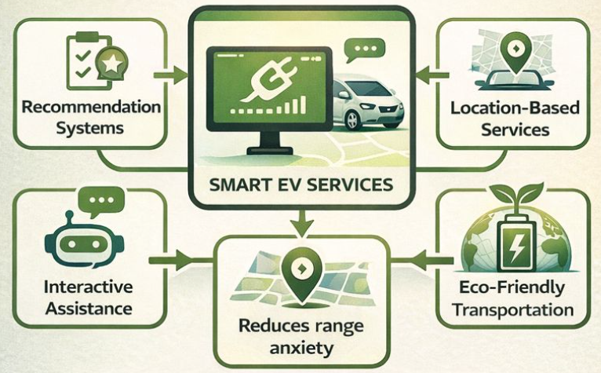
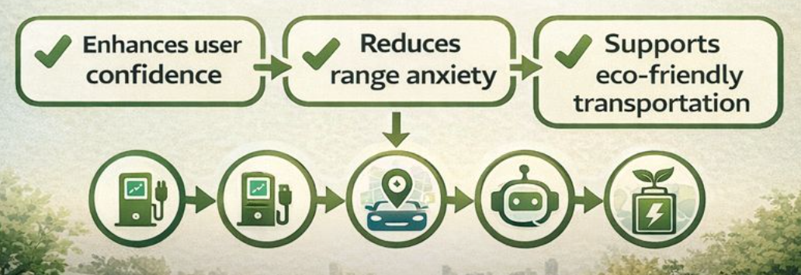
Conclusion:
The EV Assistant effectively addresses major challenges faced by EV users by combining recommendation systems, location-based services, and interactive assistance into a single platform. The system enhances user confidence, reduces range anxiety, and supports eco-friendly transportation. It serves as a practical solution for both existing and prospective EV users.

Slide 11

Future Perspective
Real-time charging station availability
AI-based charging time prediction model
Live route optimization with traffic data
Charger type compatibility filtering
Mobile application version
Integration with Google Maps / OpenStreetMap APIs
User profiles and trip history tracking
GitHub Link: GitHub - sejalshir60/EV-Assistant

Slide 12
Thank You
Notes:
Thank You !!

